Slide 1


The Scottish Parliament Election 2026: Analysis and Reflections
Professor Ailsa Henderson

Slide 2
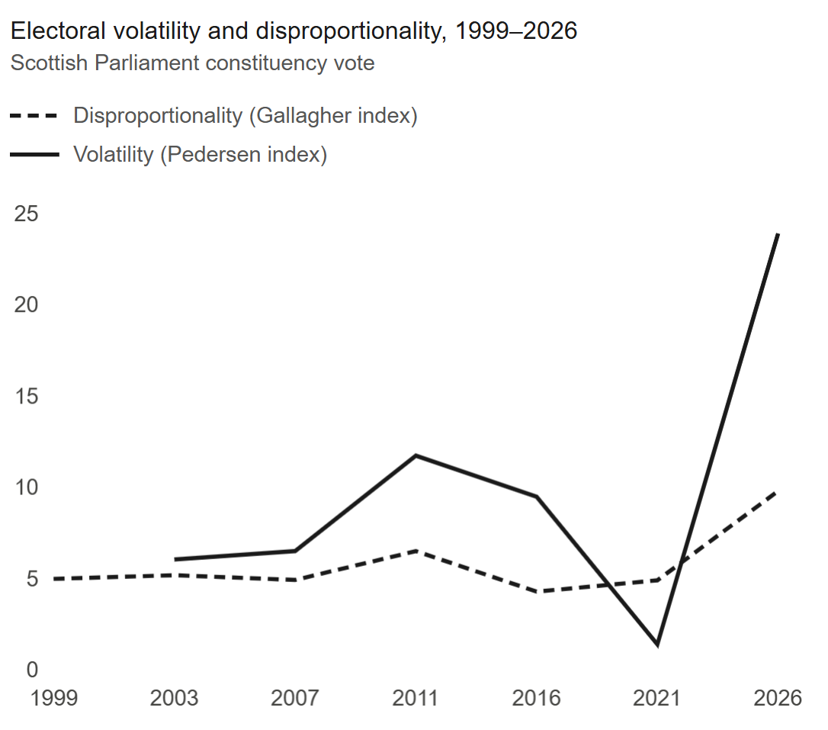
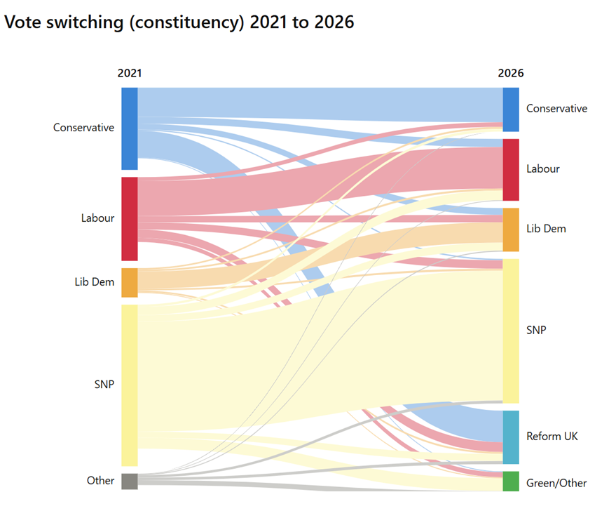
The 2026 election
Rise of volatility & disproportionality
Vote switching
Notes:
Result was that this was the most volatile and disproportionate election in history – even though it perhaps didn’t feel like that
Obviously part of that explained by vote switching, explained in part by arrival of a new party
Reform – drawng from Cons but also from across the political spectrum

Slide 3
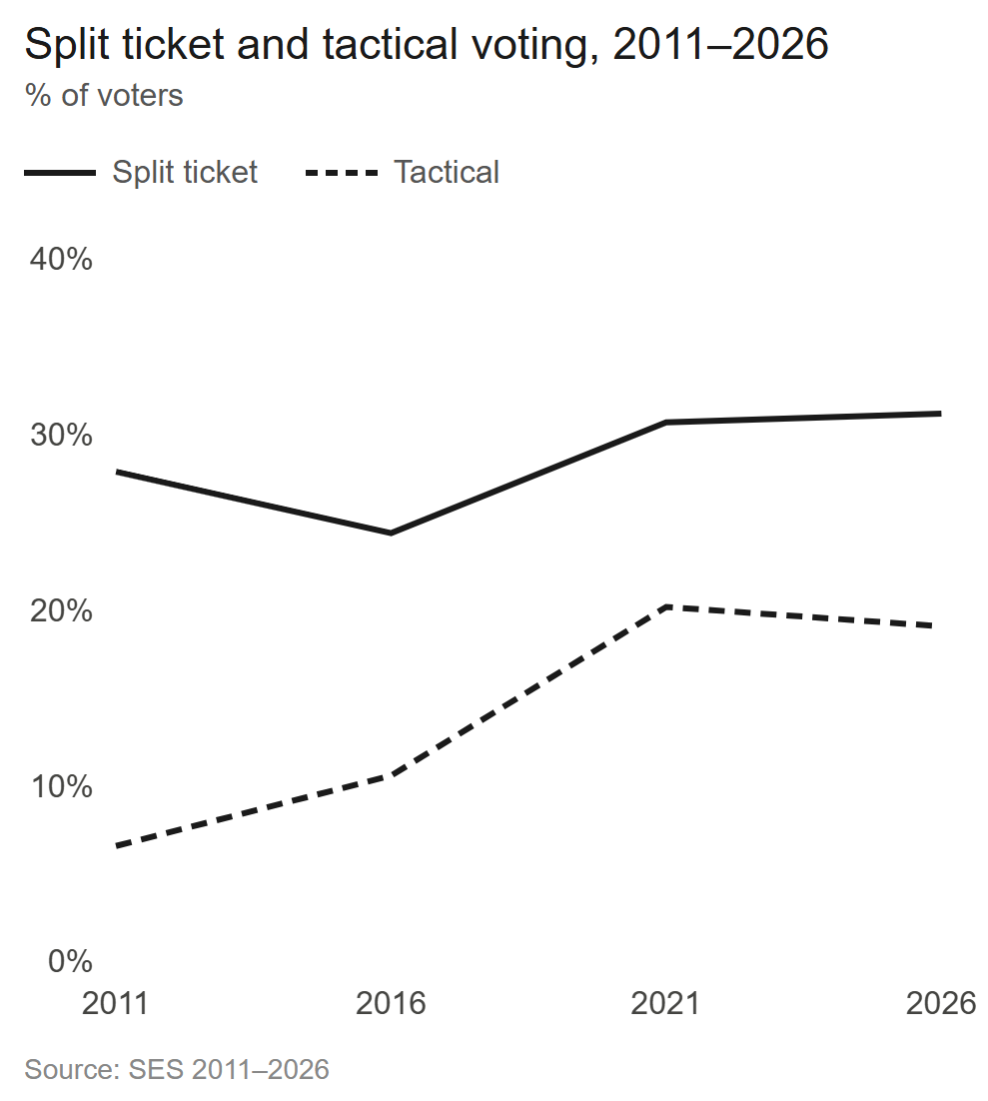
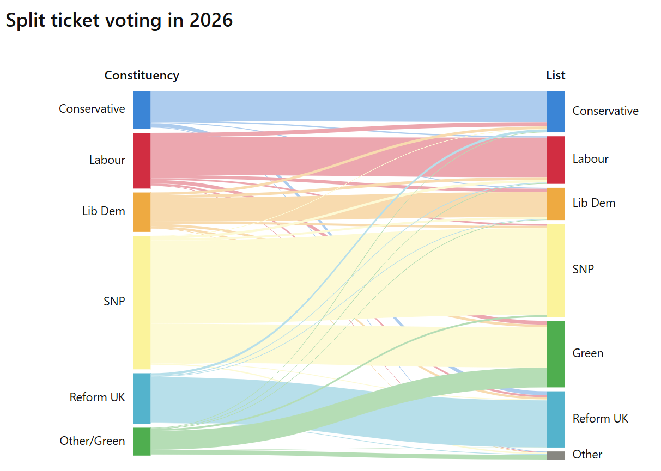
Why?
Notes:
Obviously one reason is a high level of vote switchng
But also high levels of split ticket voting (disproportionality)
(which is explained by high levels of tactical voting)
Green vote
Refor vote stickiest

Slide 4
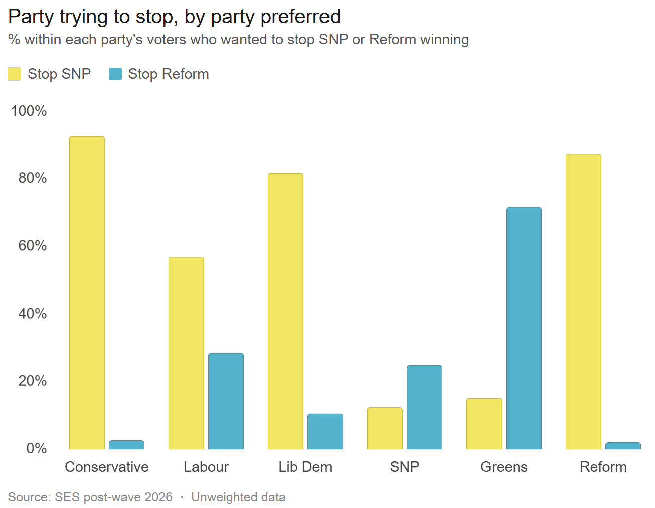
Why?
Notes:
Most of tactical voting in Scotland is anti SNP but rise of anti Reform tactical vote, esp among those who prefer Greens, Lab, SNP

Slide 5
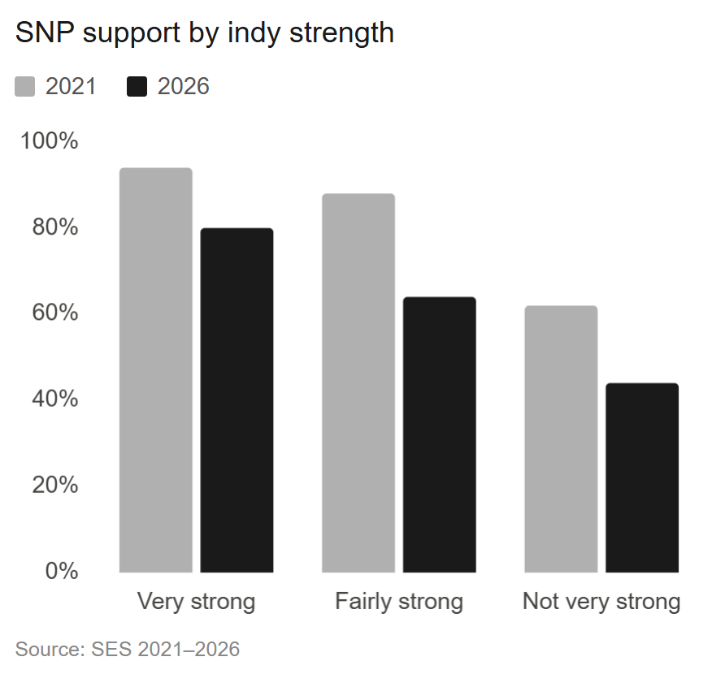
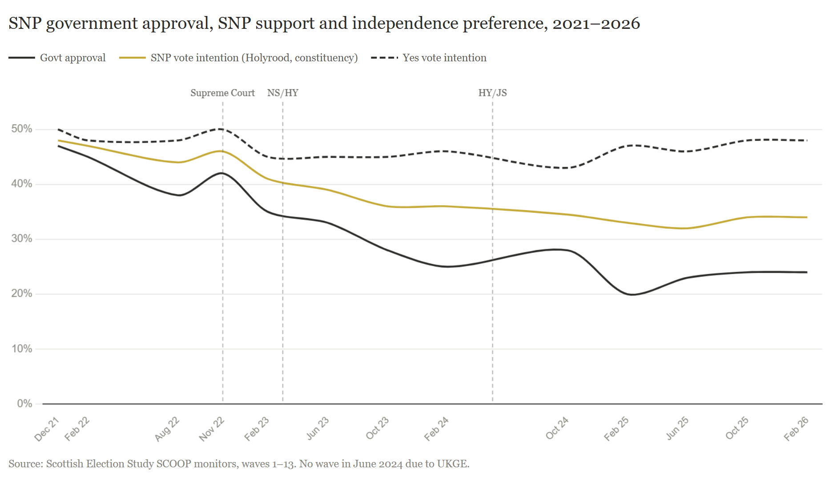
SNP evading costs of governing. Helped by …
…steady indy support …
… if a decreasing role in vote
Notes:
Our SCOOP data allow us to track trends since last election
Declining government approval had a negative impact on SNP vote intention throughout period
But limited impact on indy support which remained high
Constitutional prefs STILL align with vote choice but slightly weaker than in 2021
Received support from less than half of the ‘not very strong’ Yes identifiers
Trends over longer periods in dataset control or polling house effects bc stay with YouGov

Slide 6
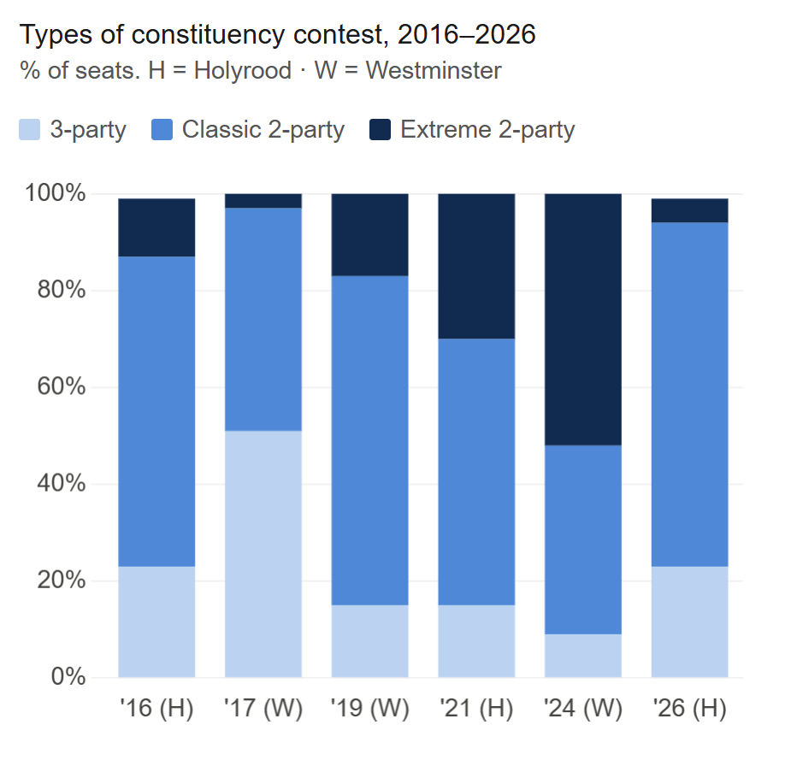
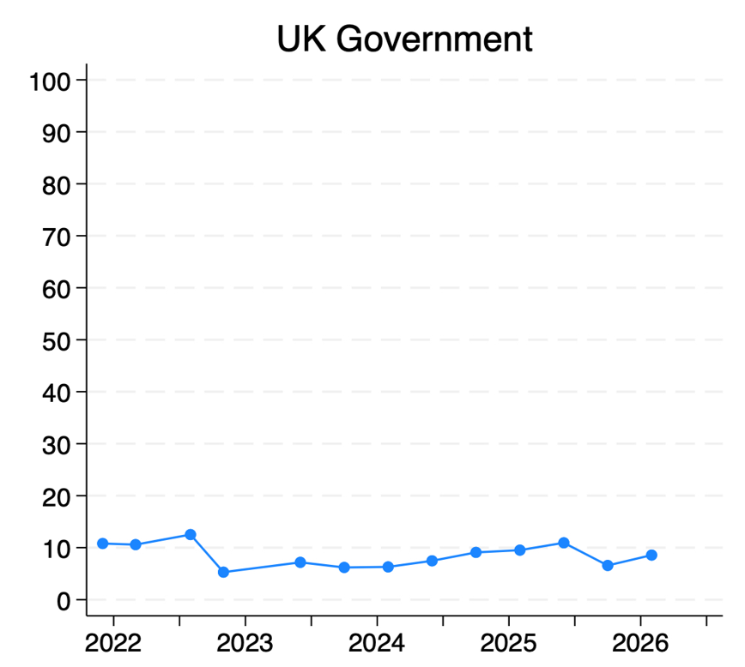
But specifically helped in this election by
Reform standing/Greens not
UK govt (dis)approval
Notes:
Sc electorate had become more strategic since 2016 – arrival of extreme 2 party contests in which other pro-union vote shares were depeleted below 10% to swing begind party best able to defeat SNP
By 2026 that had evaporated because of expressive voting for Reform.
In the 57 constituency seats won by SNP, in 50, the combined pro-union vote was higher
Level of tactical voting was similar but the extent to which it was properly strategic was just not right
Green decision NOT to stand
Had they stood in more constituencies and achieved just half of their WORST performance (which was 8% in Shetland) they would have deprived the SNP of 6 seats
Lab, LD, Reform would have picked up one each, Cons 3
East Lothian Coast and Lammermuirs to LAB
Inverness and Nairn to LD
Banffshire and Buchan coast to Reform
Eastwood to Cons
Ab East to Cons
Ab Deeside and N Kincardine to Cons
UK govt disapproval
Worse under Lab/Starmer in May 2026 than under Con/Johnson in May 2021

Slide 7
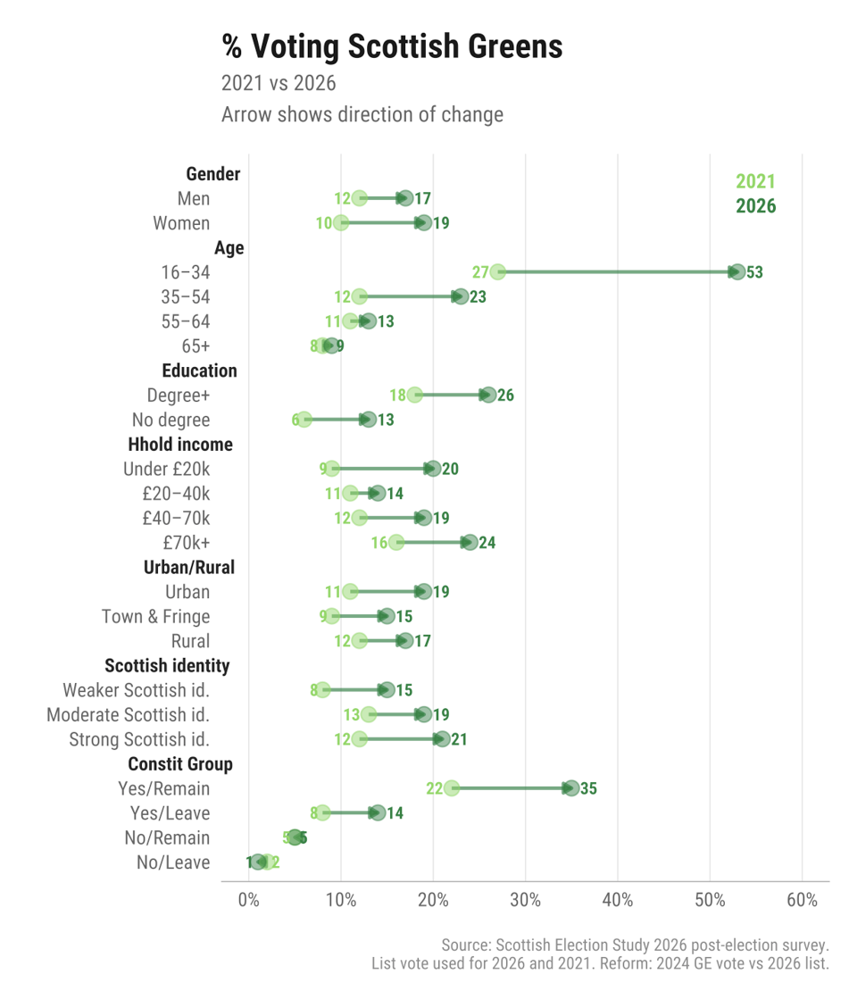
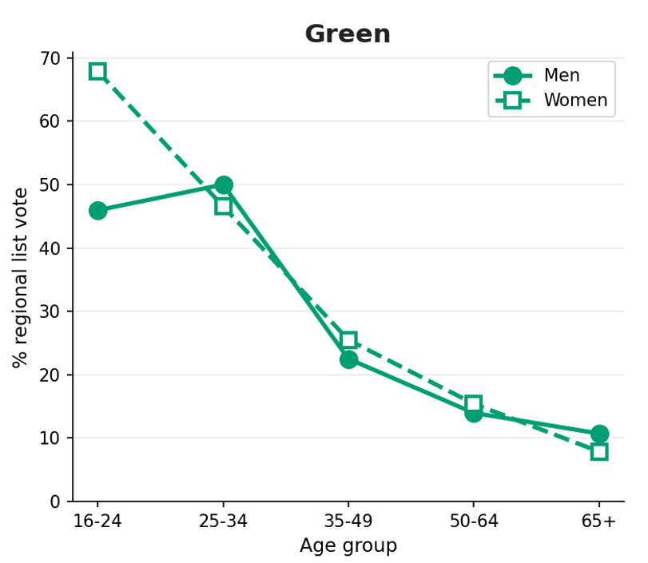
Green surge, esp among young
G
& esp among young women
Notes:
Election saw significant rise for Greens. What explains it?
CAVEATS: these are unweighted data
LEFT graph:
Green support up in all demogs except No/Leavers
Up most among young
RIGHT:
particularly so among youngest women

Slide 8
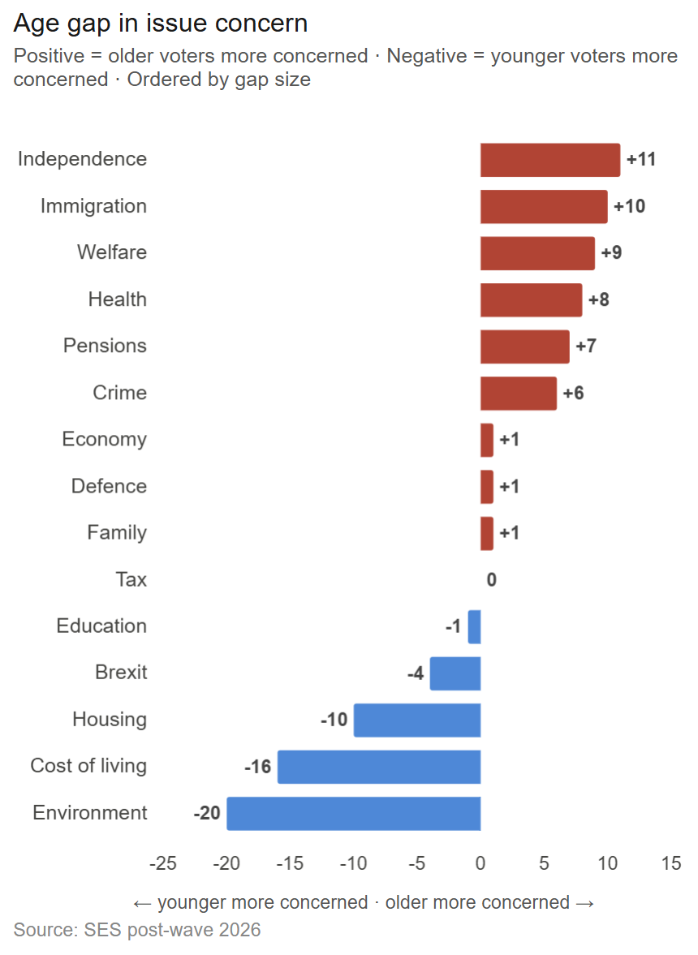
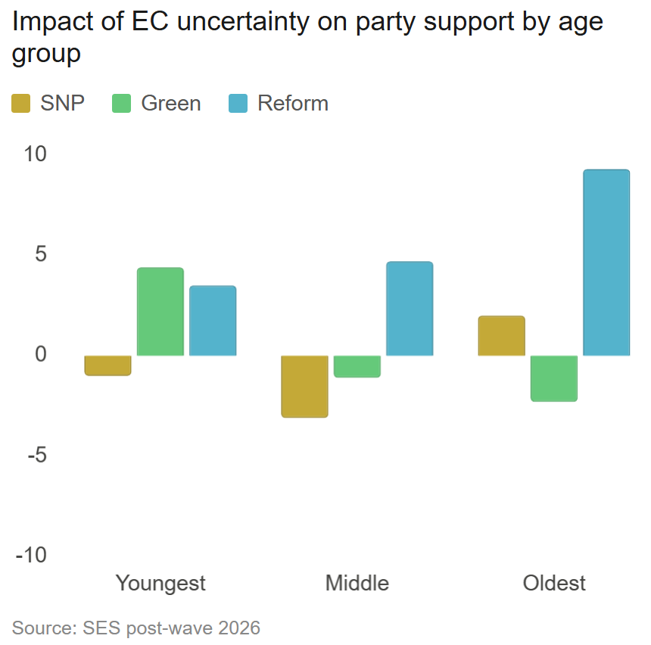
Is explained by different issue salience…
…different issue salience
…& different rx to ec uncertainty
Notes:
Is explained in part by young people paying attention to different issues, and responding differently to common issues
LEFT
Salience of issues for oldest (65+) minus salience of issues for youngest (16-24).
Oldest concerned with independence (not necessarily PRO – can also come from concern over ANTI – this is salience not position) and immigration, welfare
YOUNGES: environment, cost of living, housing
Question is MII
RIGHT
Different reactions to economic uncertainty by age. This is difference in support for parties by age group, comparing those who are economically uncertain vs those who are certain
Question is how concerned are you …
Older uncertain folks back Reform
Younger uncertain folks back Greens

Slide 9
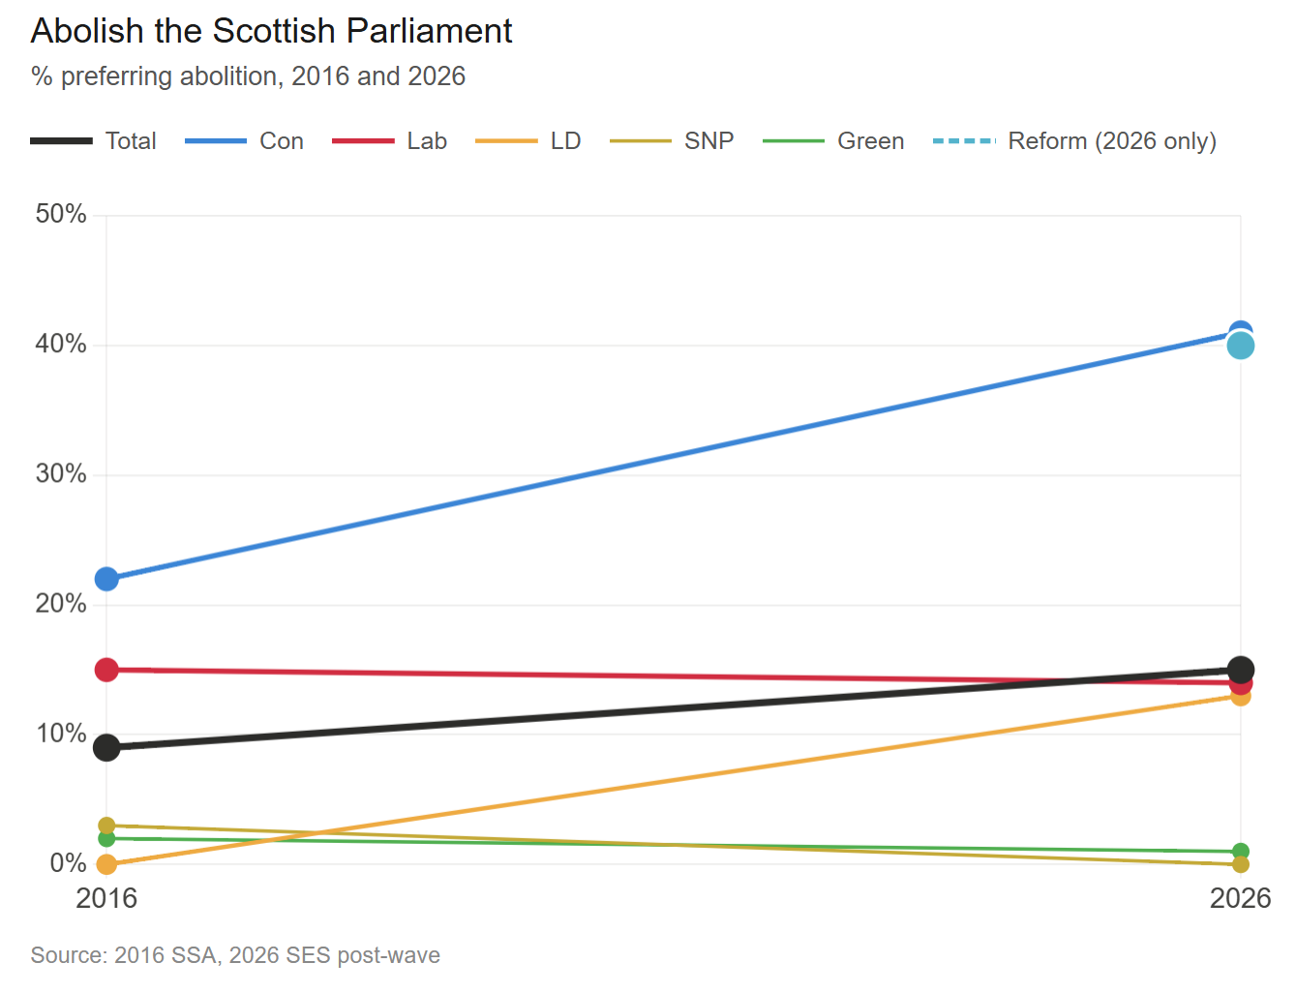
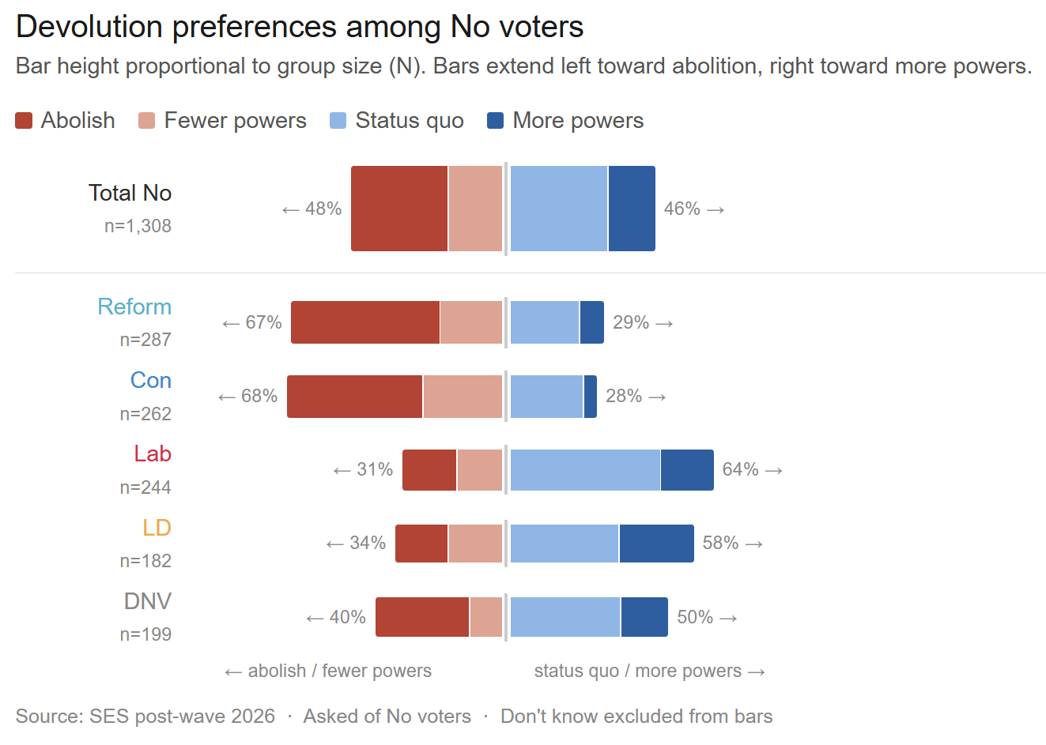
The changing poles of constitutional debate?
Rising support for Abolish
No voters now split 50:50
Notes:
Earlier graph shows fairly static support for independence 2021-2026, which implies stability in constitutional attitudes but masks change in attitudes to devolution
LEFT: SSA question asked of ALL voters
(2016 data from SSA, 2026 from us – was asked of all voters)
Trend lines show doubling of support for abolish among Con voters in last decade
Is now preferred constitutional option among Con, Reform voters (over status quo, fewer powers)
RIGHT: our new question about devolution, asked of NO supporters
No electorate split 50:50 between fewer/abolish and status quo more
All of this suggests the poles of constitutional debate are changing – we’re used to status quo to indy, now abolish to indy
(if asked why we have a new question, the SSA question is abit outdated
Indy in EU, indy out, status quo, parl with no tax powers, abolish – ignores more powers
In June SCOOP this question will be asked of ALL sample

Slide 10

Thank you
For more info:
www.scottishelections.ac.uk
ailsa.henderson@ed.ac.uk
Or follow us on bluesky (@scotvoting) and linkedin
https://tinyurl.com/SES-evaluation

